Slide 1
Before using this template, download and install the Montserrat font:
https://fonts.google.com/specimen/Montserrat
The following slides are available for you to choose from, to optimize your presentation.
The last slide provided should be your final slide; do not change the content of the final slide.
Any slides here that you do not use should be deleted from your final presentation, except the final slide provided.
If you need additional slides of a specific style, just “duplicate” the slide and enter your content onto the new one.

Slide 2


Presenter’s Name

Slide 3

Title of Presentation

Slide 4
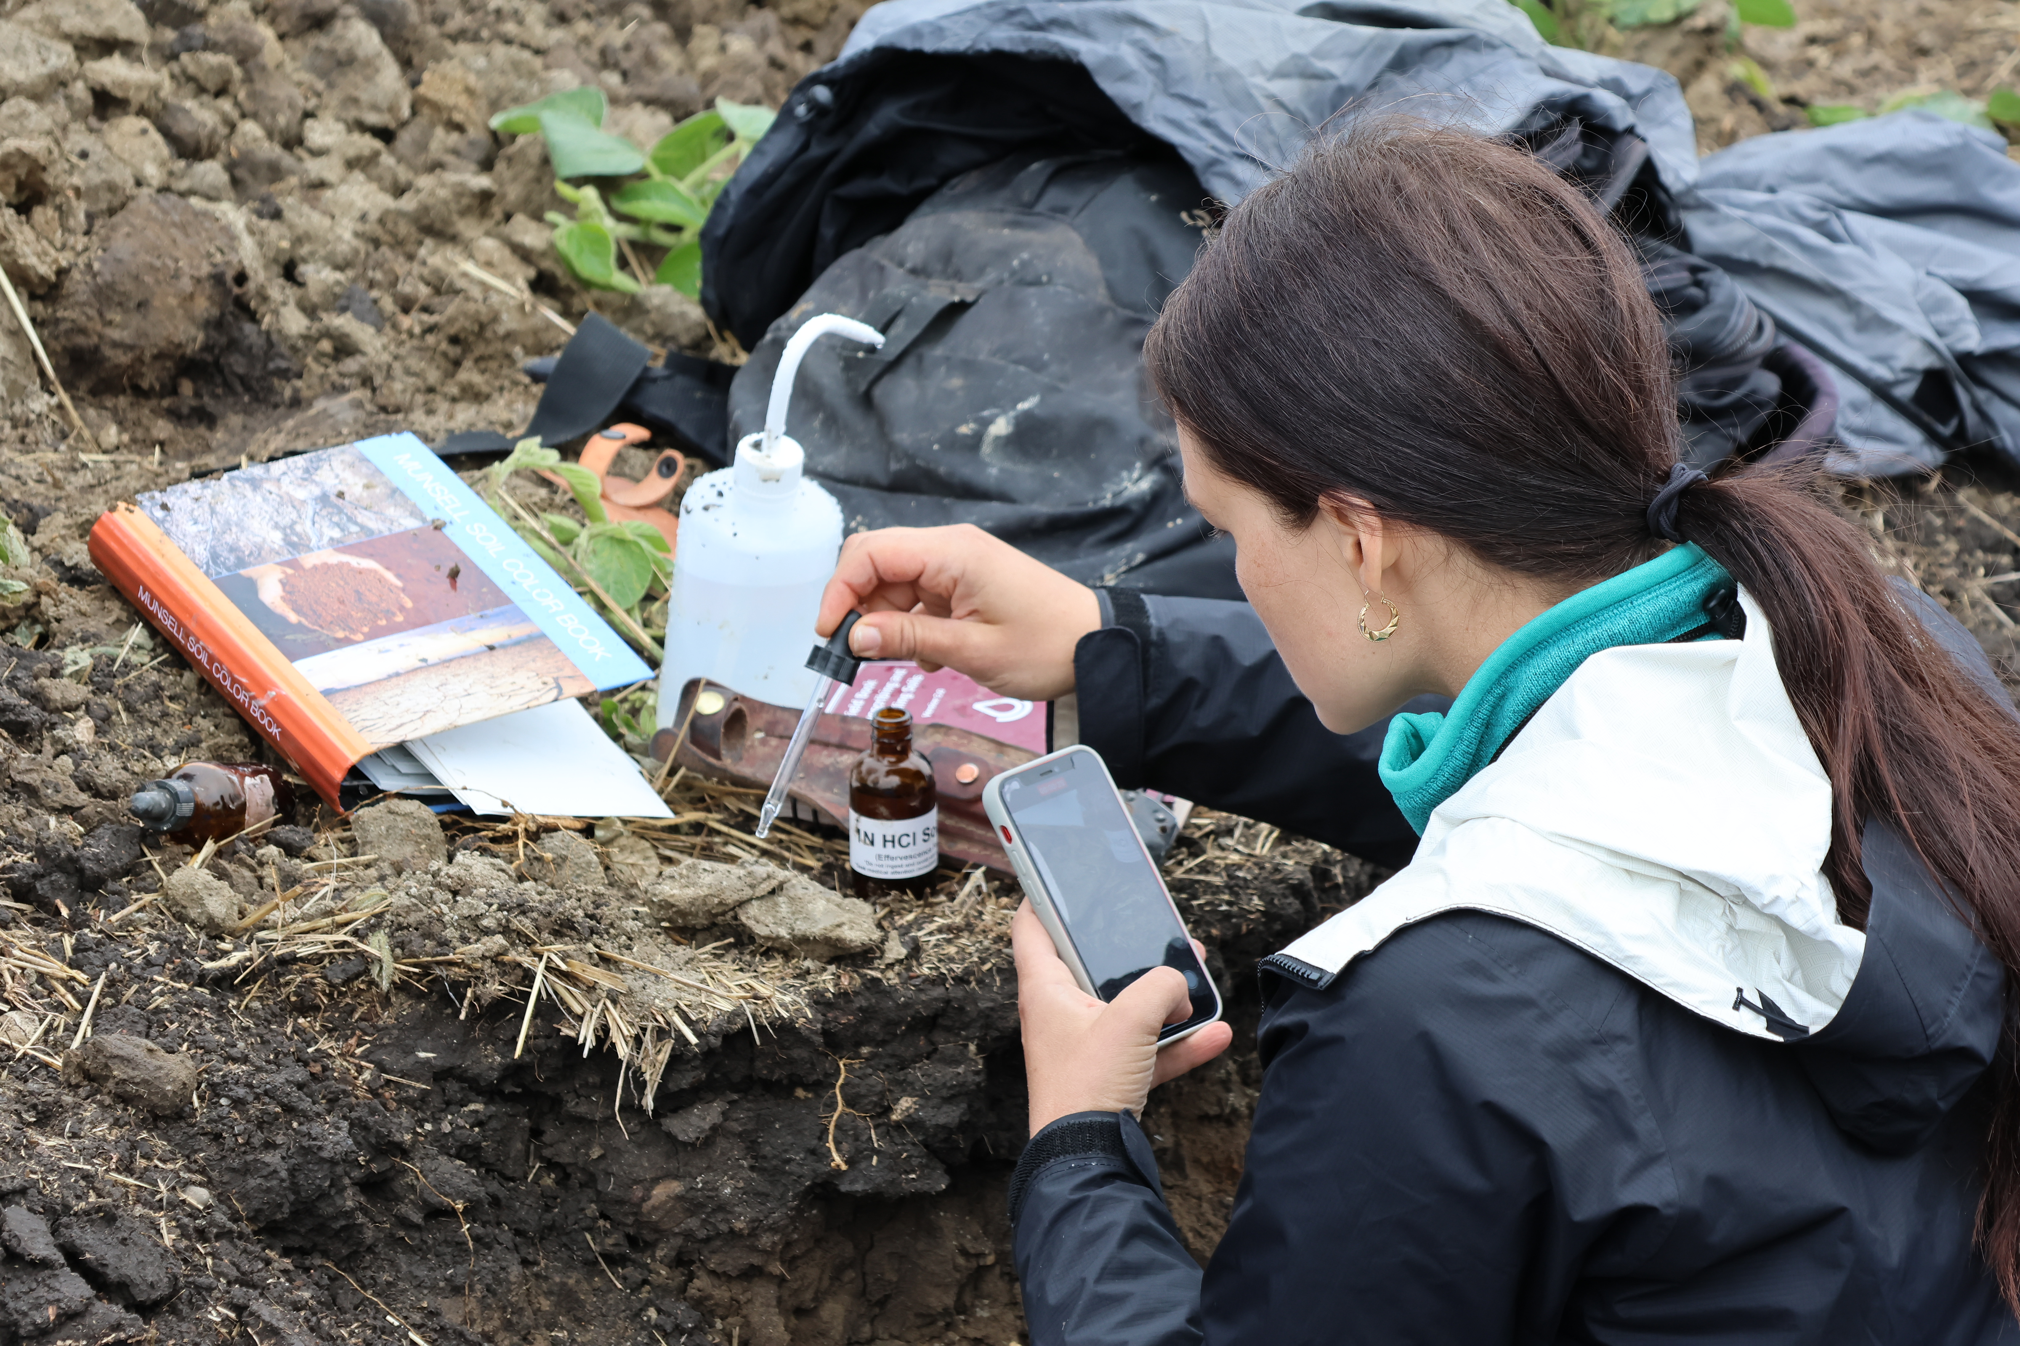
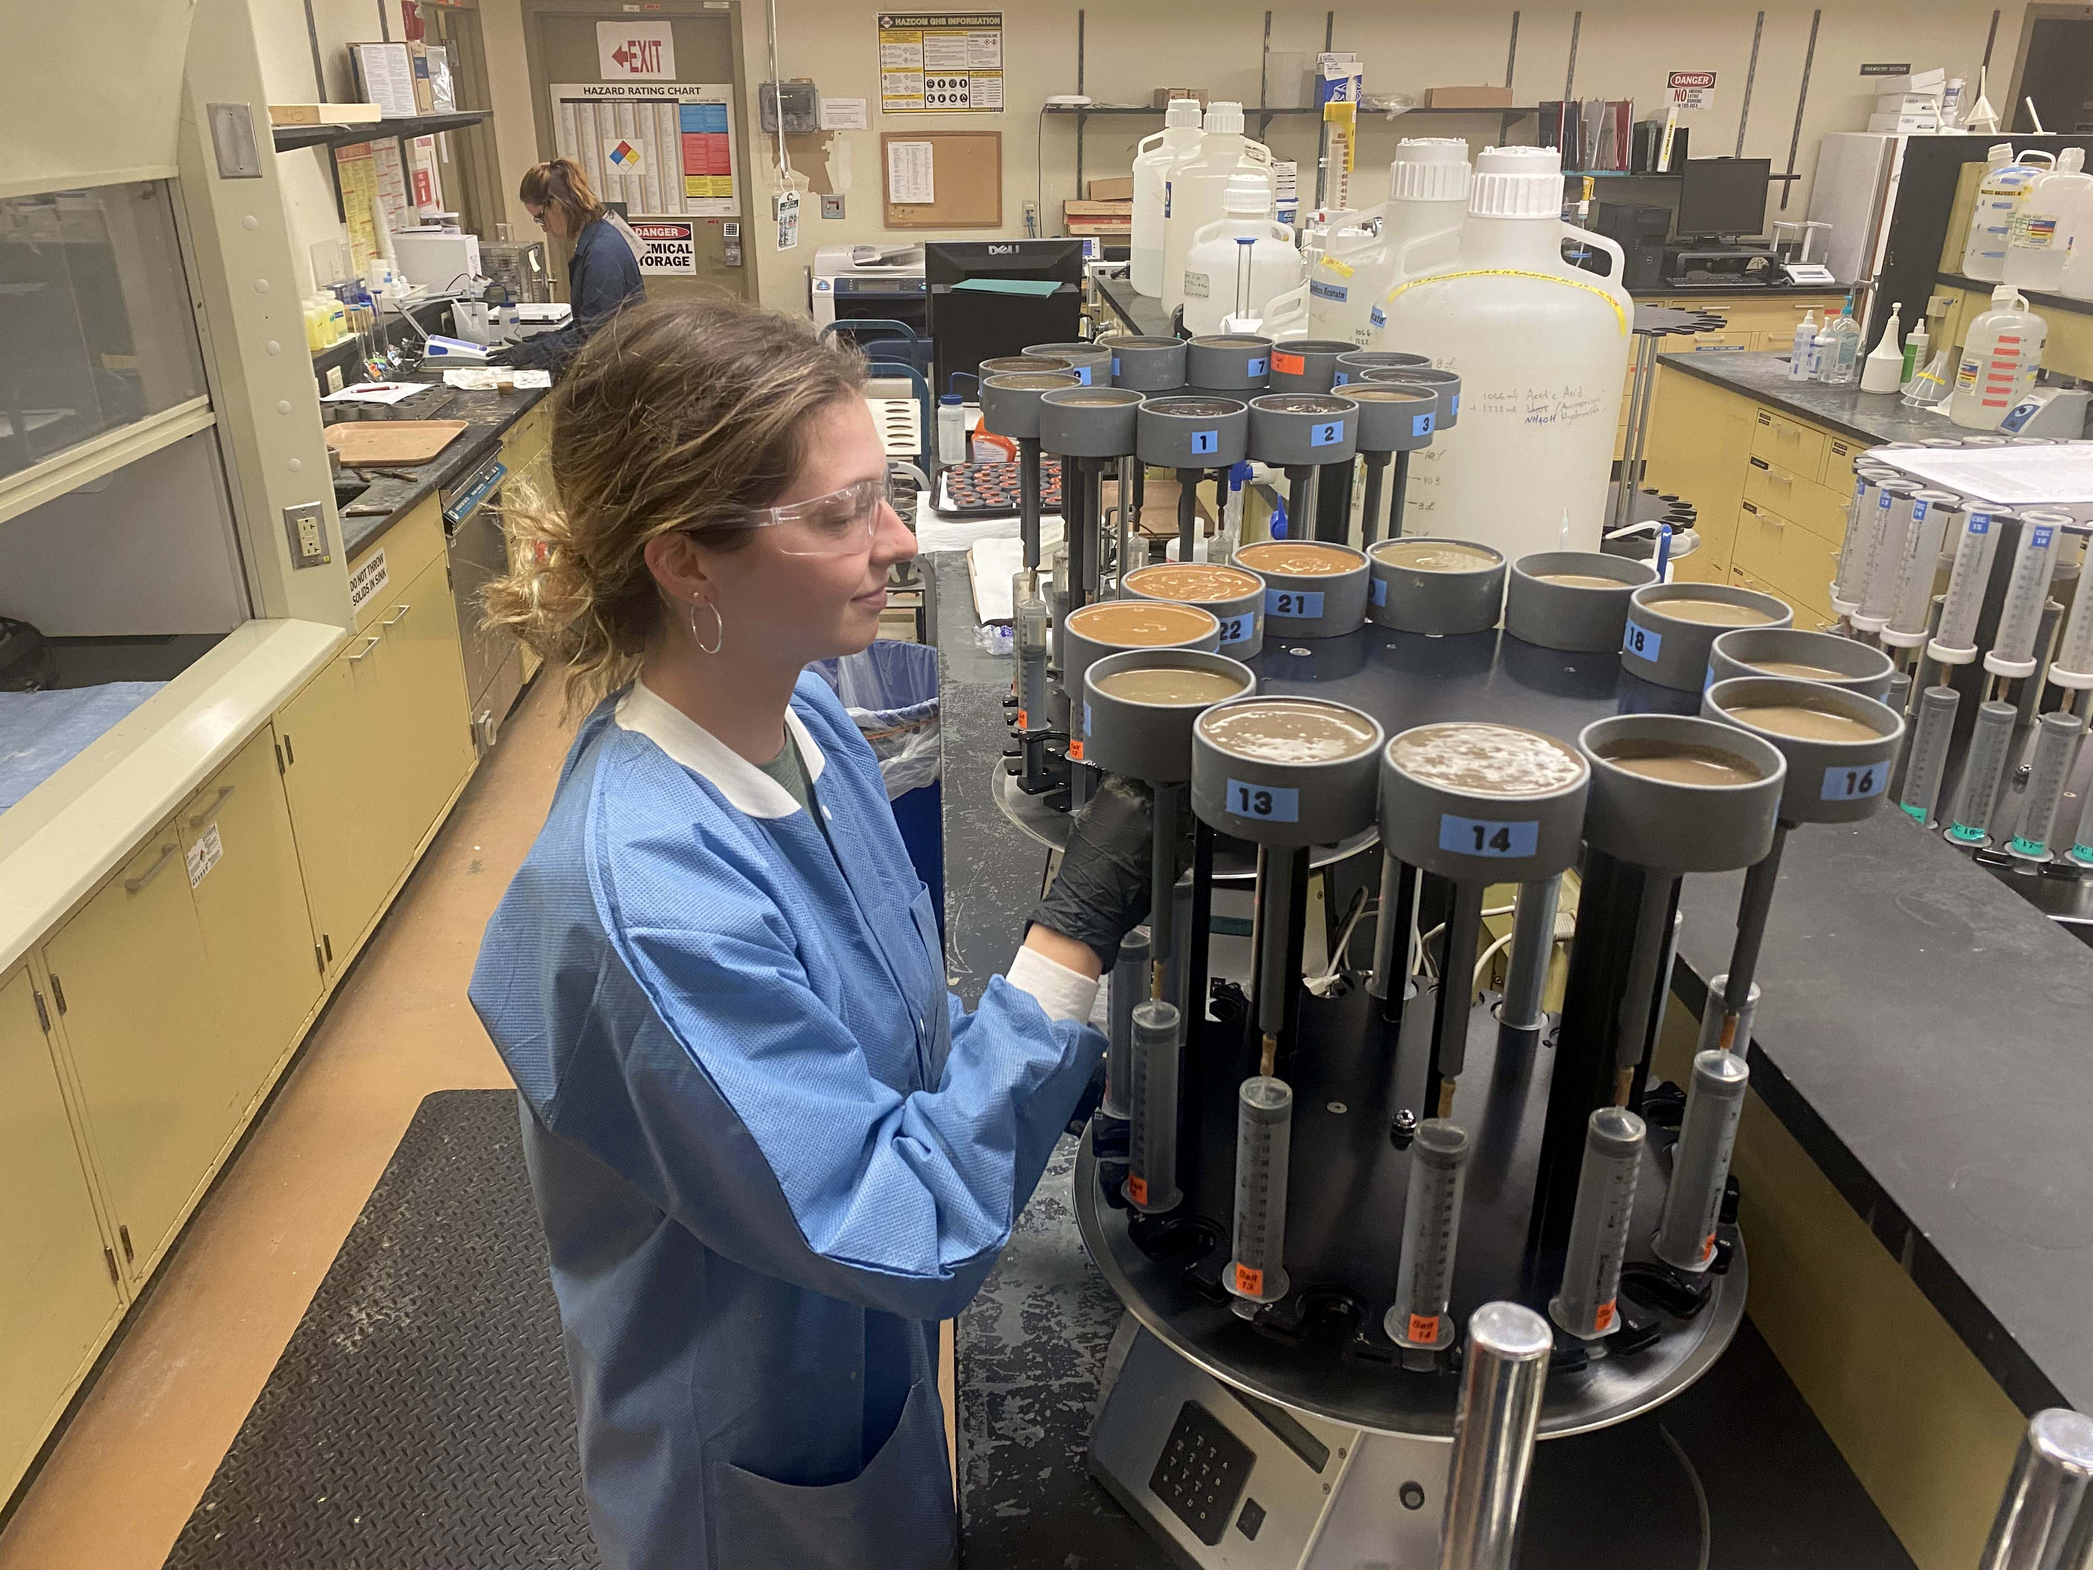
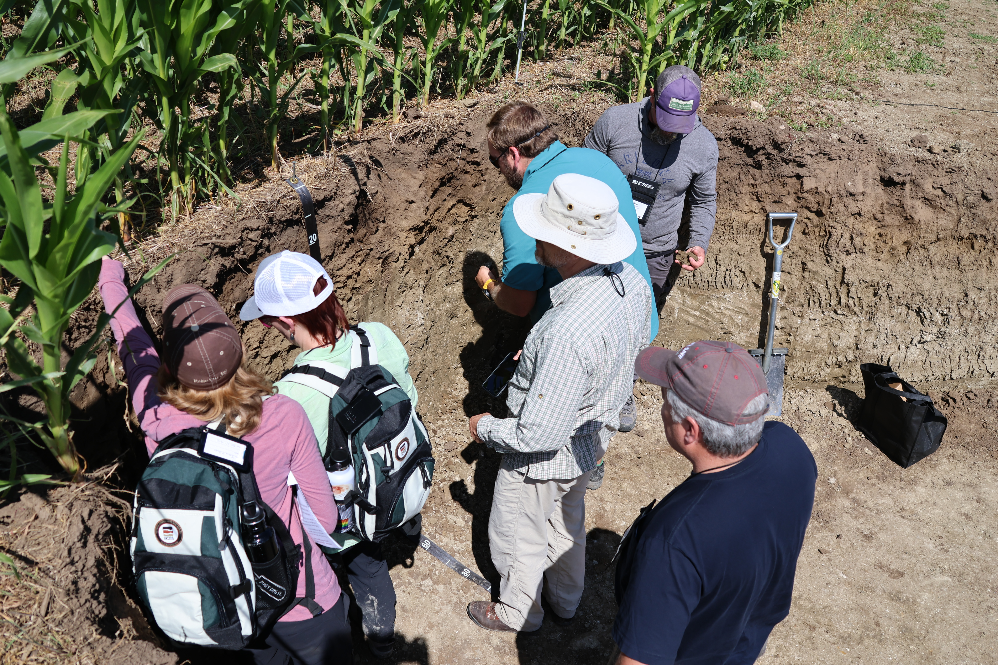
Title of Presentation

Slide 5
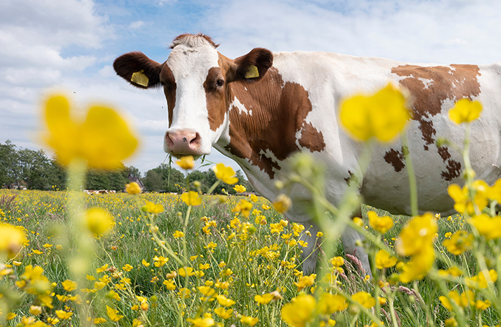
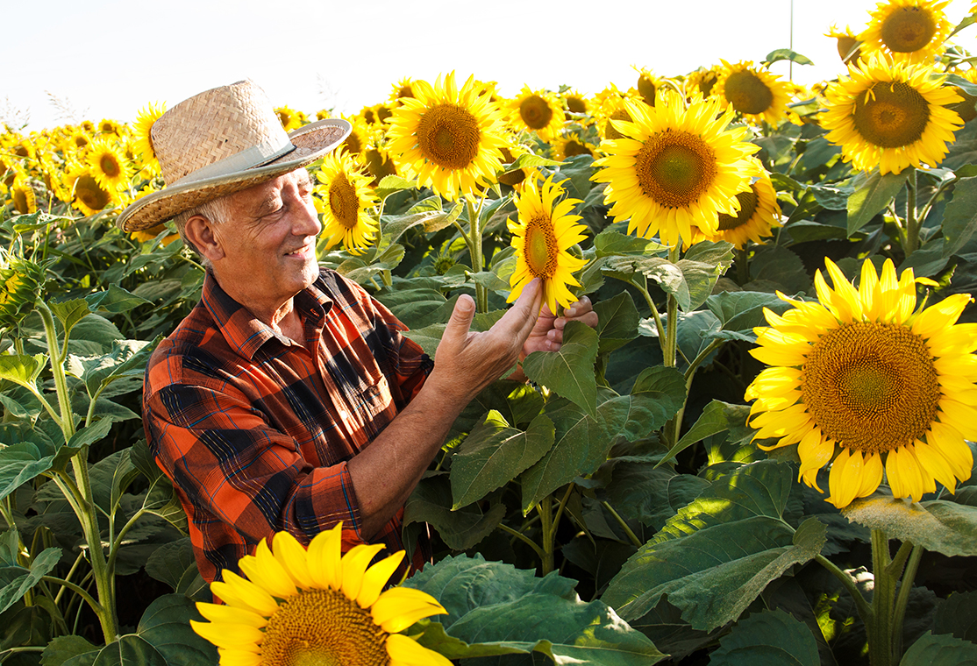
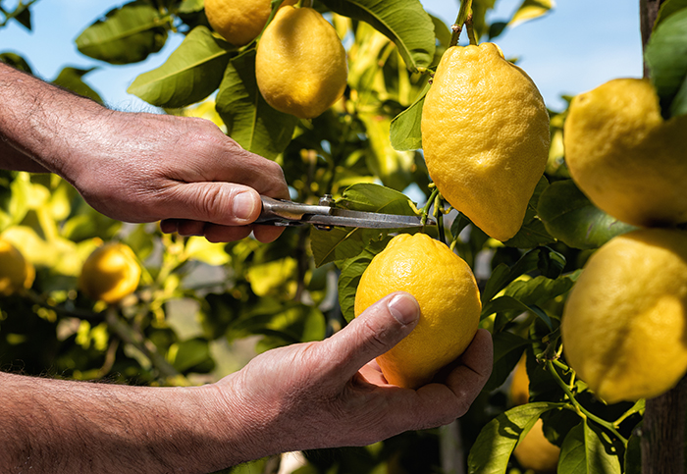

Title of Presentation

Slide 6
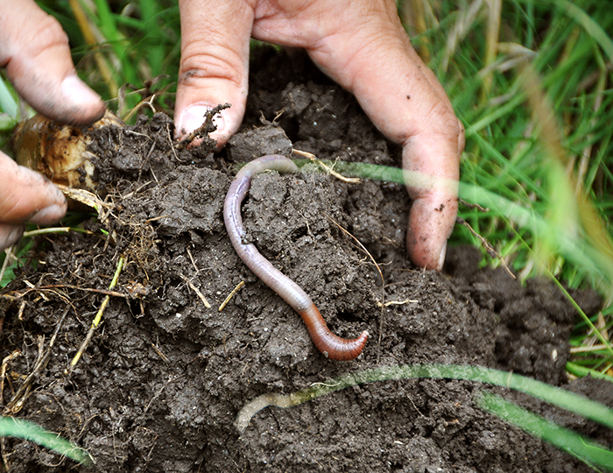
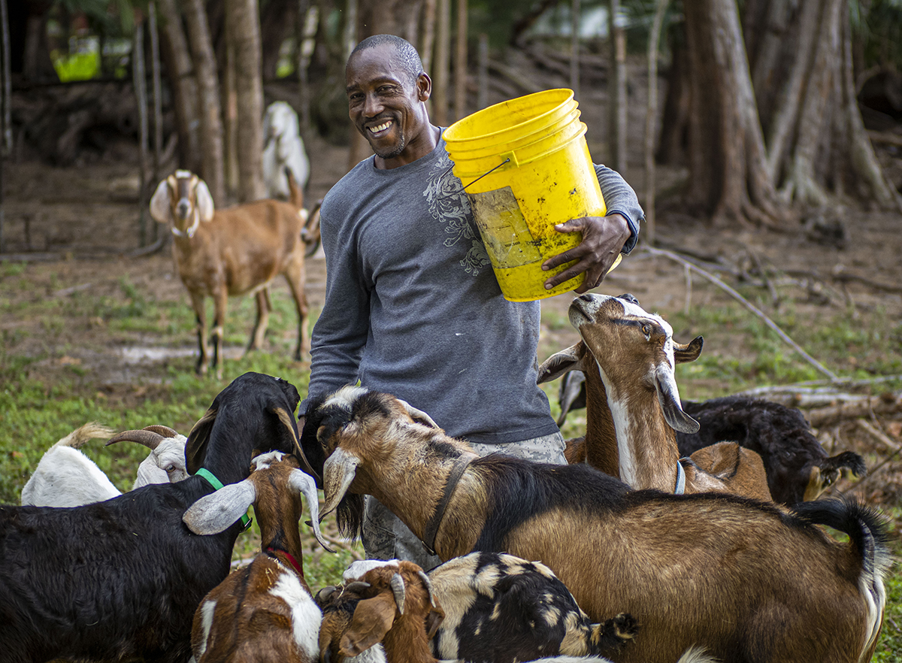
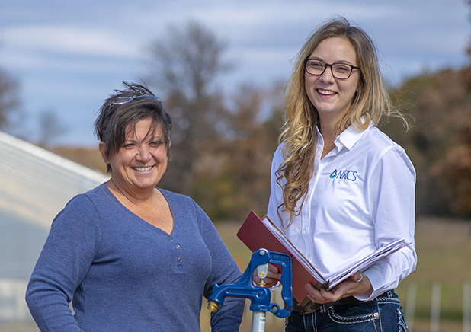
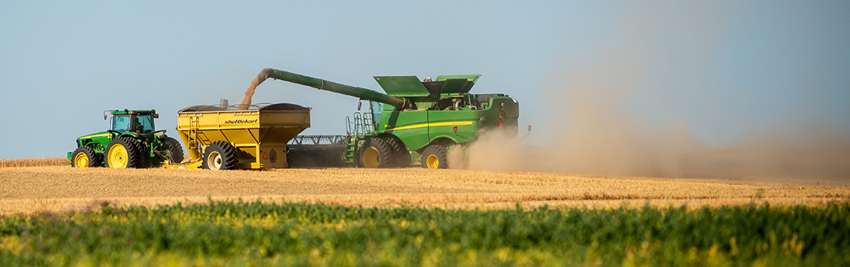
Title of Presentation

Slide 11
Table Template Option
Header | Header | Header | Header | Header
Body | Body | Body | Body | Body

Slide 12
Table Template Option
Header | Header | Header | Header | Header
Body | Body | Body | Body | Body

Slide 13
Slide Title

Slide 14
Questions

Slide 15
Thank you!
For more information on Managing Soil Health,
visit us here:
https://www.nrcs.usda.gov/conservation-basics/natural-resource-concerns/soils/soil-health
USDA is an equal opportunity provider, employer, and lender.

